Slide 1


Fredonia, AZ:
Water Safety and Conservation Study
Team: Desert Rose H₂O
Abdulrahman Alkandari
Abdulaziz Malek
Stephen Taylor
Hanako Ueda

Slide 2
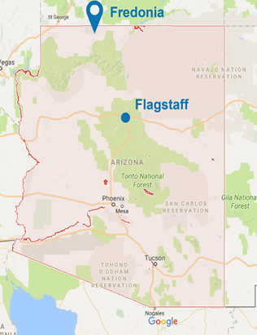
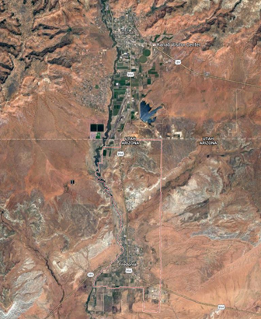
Project Background
-Location: Fredonia, AZ
-Population: 1,323 citizens
-Problem: Water source depletion
-Objectives:
Characterize Navajo Sandstone Aquifer
Characterize distribution system
Develope scaled response for a 20 year projection
Kanab, UT
Fredonia, AZ
Figure 1: Arizona Map [1]
Figure 2: Aerial Map of
Fredonia [1]
Aziz, 1
Notes:
AZIZ

Slide 3
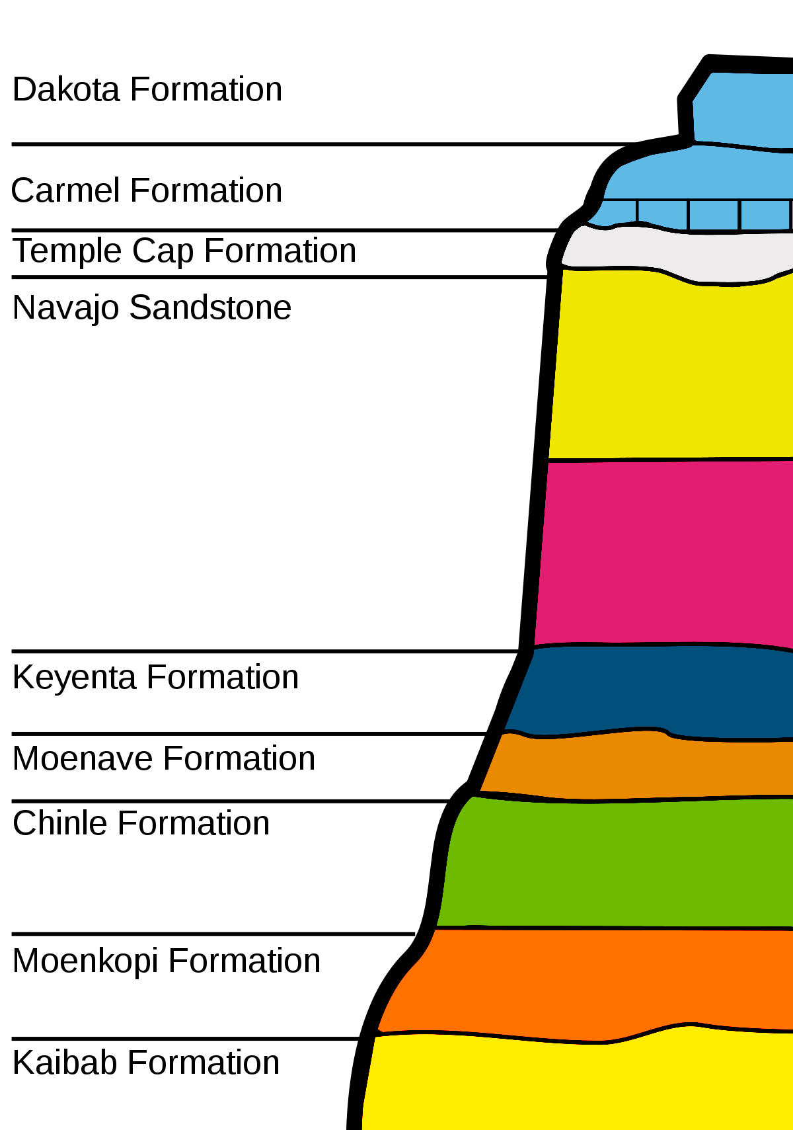
Aquifer Characterization
Dakota Formation
Carmel Formation
-Elevation
Between 5,500 ft and 6,300 ft
-Two Layers
Upper Navajo Sandstone: 6,000 ft to 6,300 ft
Lower Navajo Sandstone: 5,500 ft to 6,000 ft
-Saturated Thickness
450 ft, with partially saturated characteristic
-Hydraulic Conductivity
Approximately 4.2 X 10⁻⁶ ft/s
Temple Cap Formation
Upper Navajo
Navajo Sandstone Formation
Lower
Navajo
Kayenta Formation
Moenave Formation
Chinle Formation
Moenkopi Formation
Kaibab Formation
Figure 3: Navajo Sandstone Aquifer Layers [2]
Abdul, 2
Notes:
Moenave Formation
Chinle Formation
Moenkopi Formation
Kaibab Formation

Slide 4
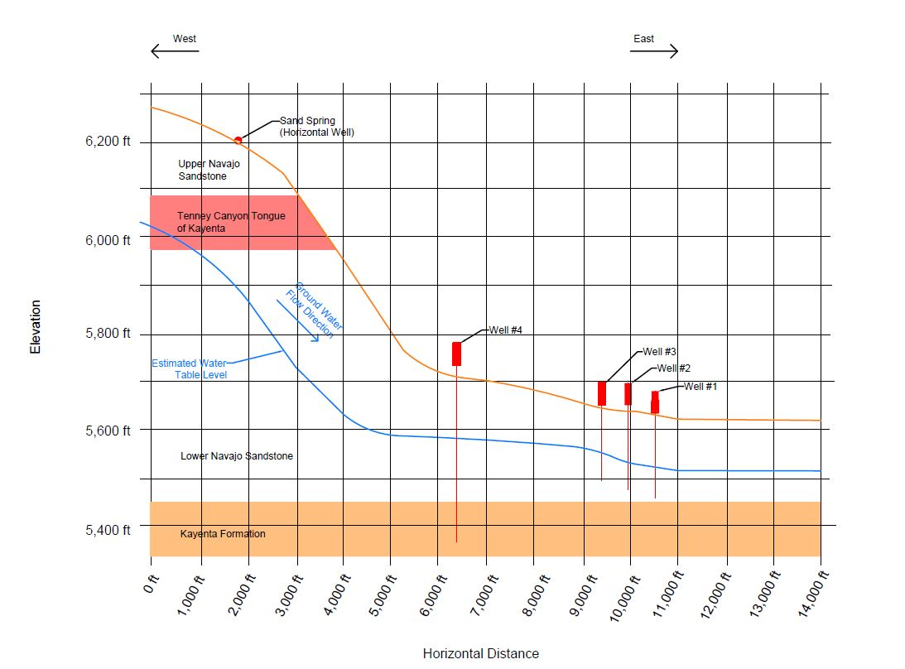
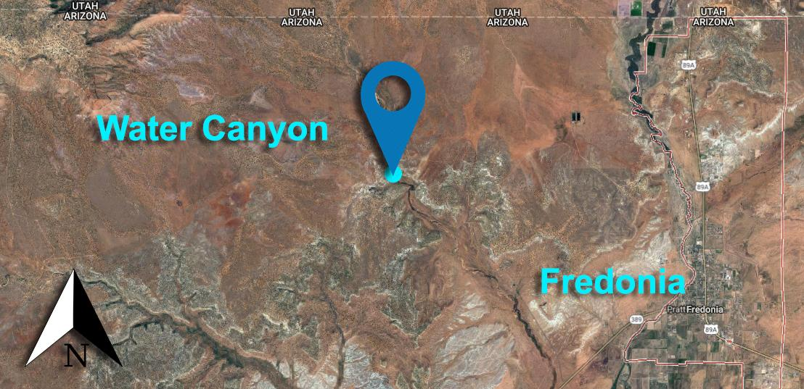
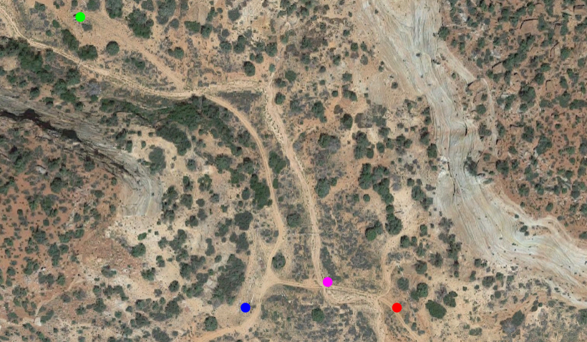
Aquifer Characterization (cont.)
(Utah)
Figure 5: Source Well Location Relative to Fredonia
Well #4
Well #1
Well #3
Well #1
Figure 6: Well Locations in Water Canyon
Figure 4: Profile View of The Navajo Sandstone Aquifer
Abdul, 3
Notes:
ABDUL

Slide 5
Aquifer Characterization (cont.)
-Drawdown in Source Wells Calculation. Iterative R_{o} and H₁ calculations used to solve for known Q.
Table 1: Well Drawdown Calculation Values
Component | Symbol | Well #1 | Well #2 | Well #3 | Well #4
Flow | Q | 0.056 cfs | 0.067 cfs | 0.067 cfs | 0.09 cfs
Hydraulic Conductivity | K | 4.92 X 10⁻⁶ ft/s | 4.92 X 10⁻⁶ ft/s | 4.92 X 10⁻⁶ ft/s | 4.92 X 10⁻⁶ ft/s
Well Diameter | R₁ | 0.33 ft | 0.33 ft | 0.33 ft | 0.33 ft
Radius of Influence | R_{o} | 4.04 ft | 5.47 ft | 5.47 ft | 8.44 ft
Water Levels | H_{o} | 4088 ft | 4070 ft | 4070 ft | 4090 ft
 | H₁ | 4086.9 ft | 4068.5 ft | 4068. 5 ft | 4087.7 ft
Drawdown |  | 1.1 ft | 1.49 ft | 1.49 ft | 2.3 ft
R_{o}= 300 ( H_{o} - H₁) * K²
Q = (PI*K*(H_{o}²-H₁²))/ln(R_{o}/R₁)
Abdul, 4

Slide 6
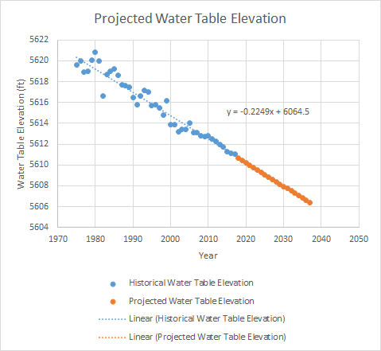
Aquifer Characterization (cont.)
-Historic elevation in 1976 [3]:
5620.0 ft
-Current elevation in 2017 [3]:
5611.08 ft
-Water table drops at nearly constant rate:
0.208 ft/yr
-Projected over 20 year period
Elevation in 2017: 5611.08 ft
Elevation in 2037: 5606.37 ft
-Water table will drop approximately 5 ft over 20 year projection
Figure 7: Projected Water Table Elevation
Abdul, 5

Slide 7
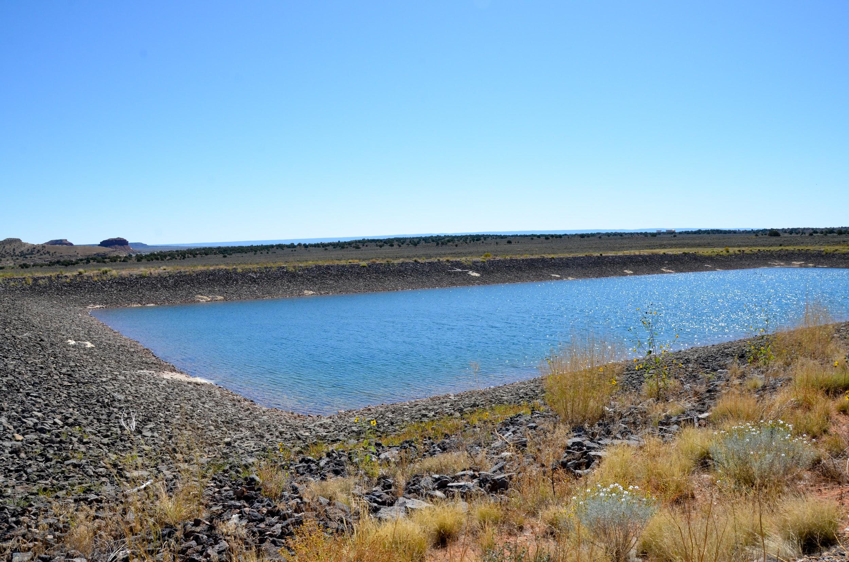
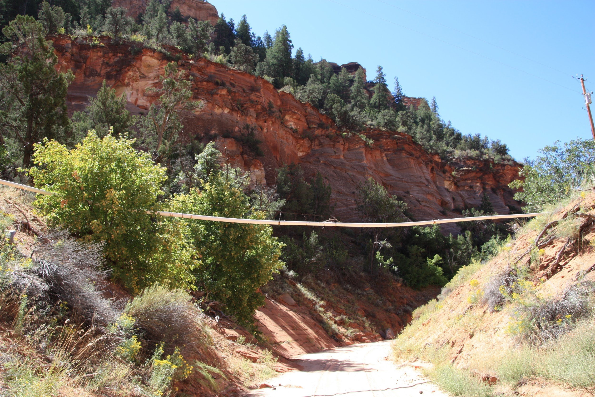
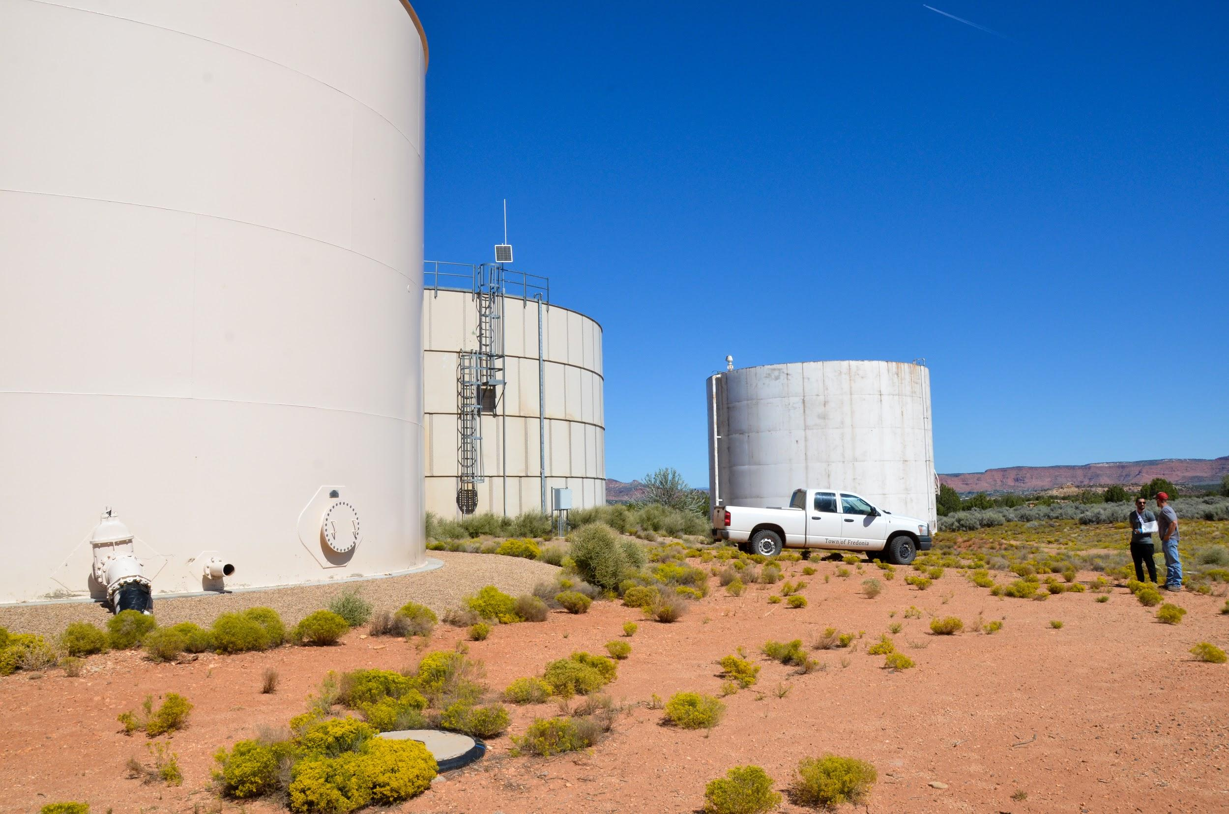
Water Distribution System Characterization
-Source Collection
Pipeline Mixed with Surface Water in Catchment Water Wells
-Distribution
Groundwater to Backwash Reservoir (15 Million Gallons), or a Storage Tank (2 Million Gallon)
Figure 9: Drinking Water Backwash Reservoir
Aziz, 6
Figure 8: Exposed Groundwater Pipeline
Figure 10: Drinking Water Storage Tanks
Notes:
AZIZ
Source Collection: # of wells, pumping rates for wells, depths of wells, elevations
Distribution: PVC material, diameters, gravity fed. They use their backwash reservoir for drinking as well since it is part of the distribution.

Slide 8
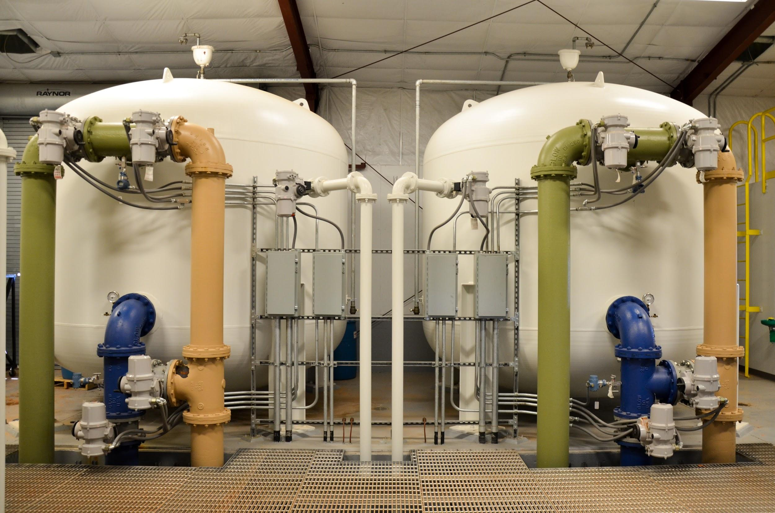
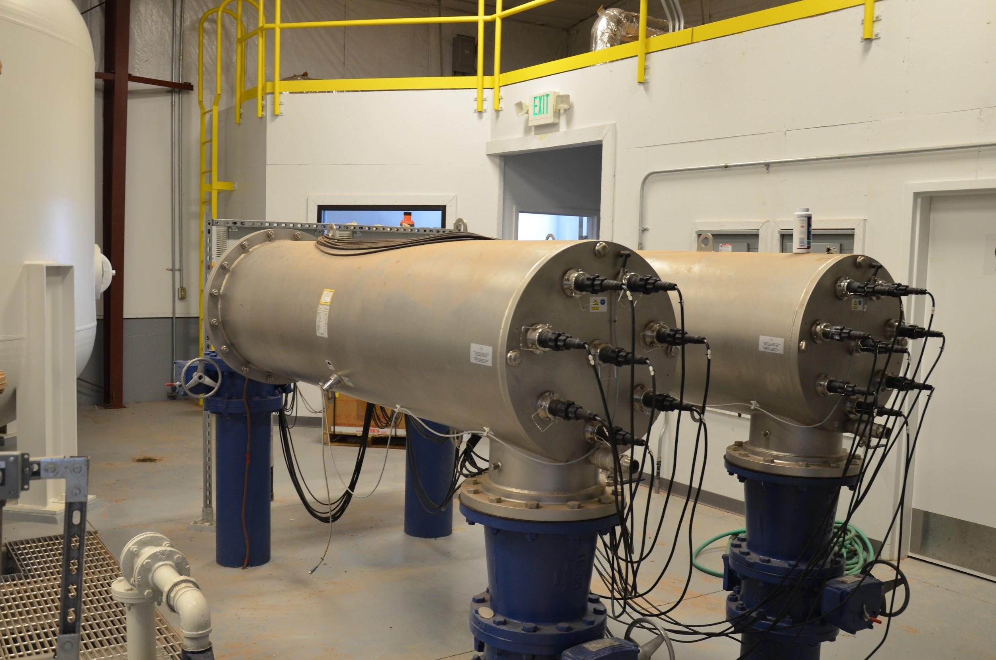
Water Distribution System Characterization (Cont.)
-Treatment [4]
Rapid Sand Filters
UV & Chlorine
Chlorine Residual Level: 0.67 ppm
-Wastewater collection/treatment [5]
Gravity Fed Sewer System
Discharged into 2 (out of 5) evaporative ponds
Figure 11: Filtration System Treatment
Figure 12: UV Treatment
Aziz, 7
Notes:
AZIZ
Treatment: mention filter types; rapid sand filters, backwashed ,goes into storage (3 tanks at 750,000gallons, 250,000 gal, 1,000,000 gal); no further treatment,
Wastewater Collection: gravity fed sewer lines to wastewater evaporation ponds. 50,000 +- 5,000 gpd

Slide 9
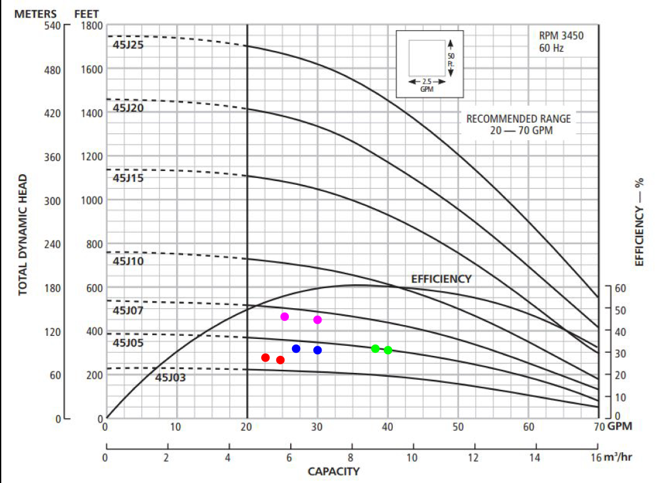
Source Well Efficiency
TDH = Head in Pump + Head losses
-Well #1:
TDH increase from 250.06 ft to 254.76 ft
Flow decrease from 25 gpm to 22 gpm
Efficiency reduces by 12%
-Well #2:
TDH increase from 470.72 ft to 474.88 ft
Flow decrease from 30 gpm to 26 gpm
Efficiency reduces by 13.3%
-Well #3:
TDH increase from 372.14 ft to 376.84 ft
Flow decrease from 30 gpm to 26.75 gpm
Efficiency reduces by 13.3%
-Well #4:
TDH increase from 372.10 ft to 376.80 ft
Flow decrease from 40 gpm to 38 gpm
Efficiency reduces by 5%
Well #2
Well #4
Well #3
Well #1
Figure 13: Generic Pump Curve for Deep Wells
*Since pump models not known, generic deep water pump assumed
Stephen, 8
Notes:
STEPHEN

Slide 10
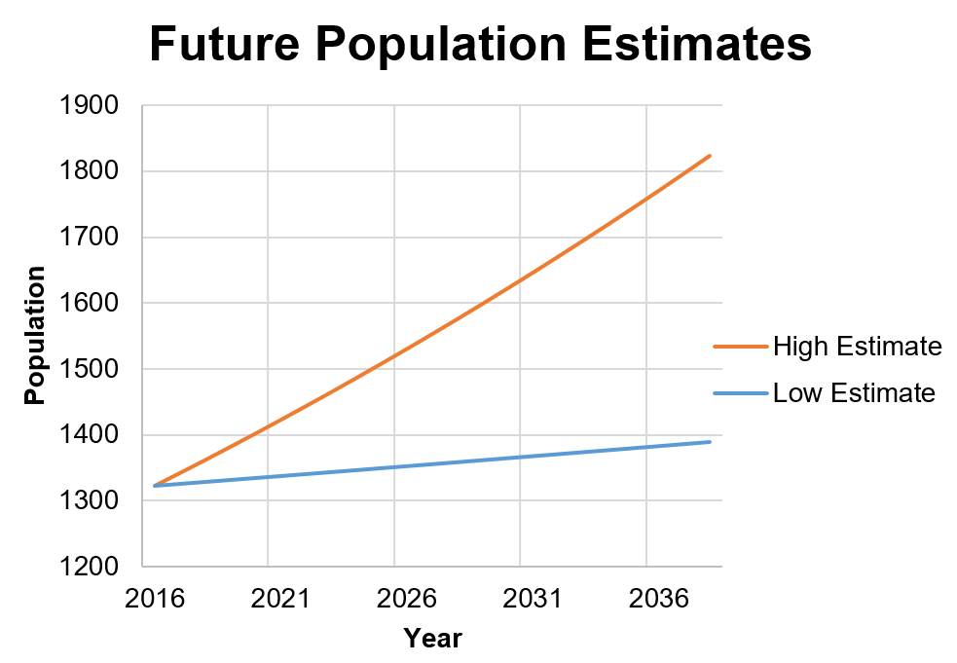
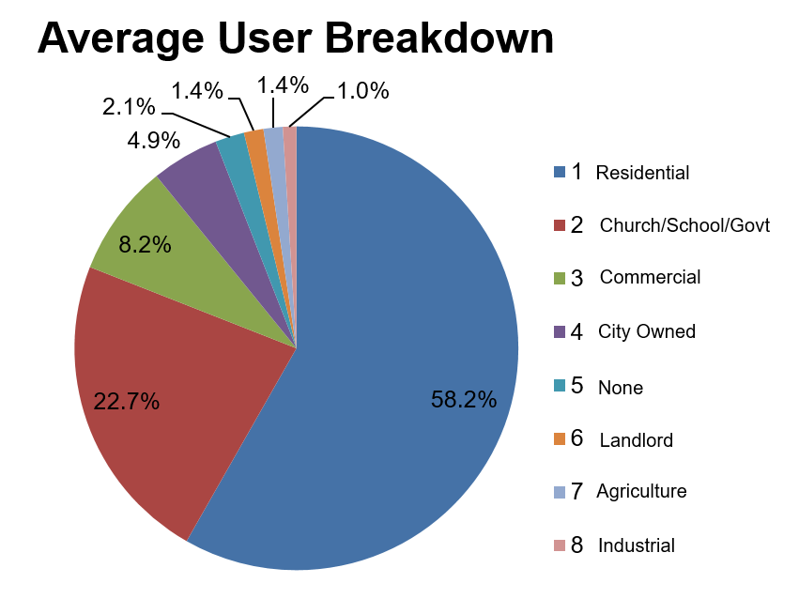
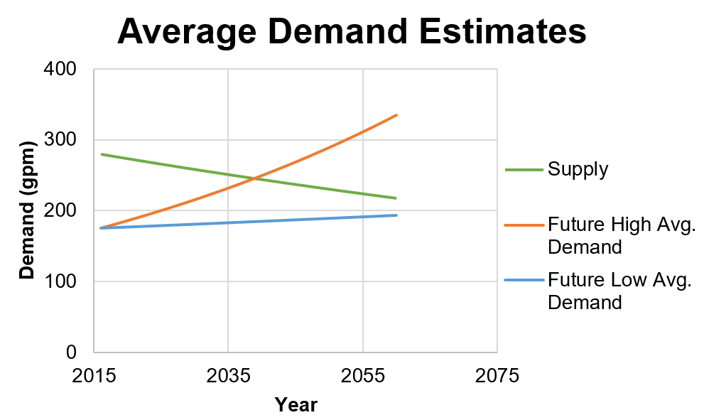
Users
1772
-20 year projection
-Assumed that demand increases at same rate as population
-High, historical growth rate = +1.47%
-Low, current growth rate = +0.22%
1.47%
0.22%
1383
Compound Growth: F=P(1+i)^{n}
Figure 15: 20 Year Population Projection
2038
Figure 14: User Breakdown
Figure 16: Water Demand Projections
Hanako, 9
Notes:
Hanako
We used the compound population growth formula to create low and high projections for population to create a range of possibilities and demands
As you can see, residents use the majority of water, and we assume water demand will increase at the same rate as population growth.
The green line is the maximum pumping capacity. Currently, they can pump 280 gpm from their wells, but as the water table in the aquifer drops, so does the pumping capability. Fredonia can produce a maximum of 280GPM, but we expect that to drop by 11%. Also what if even one of their 4 pumps stop working? Based on our calculations, we expect the average demand will exceed the supply in 2038. So why do we care when that’s 20 years away? Because the annual average is not a good representation of the extremem fluxuation in water usage between seasonal use.

Slide 11
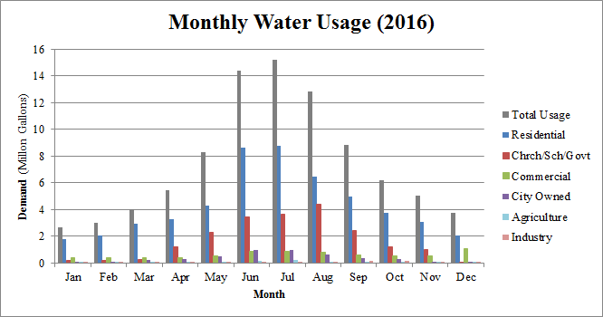
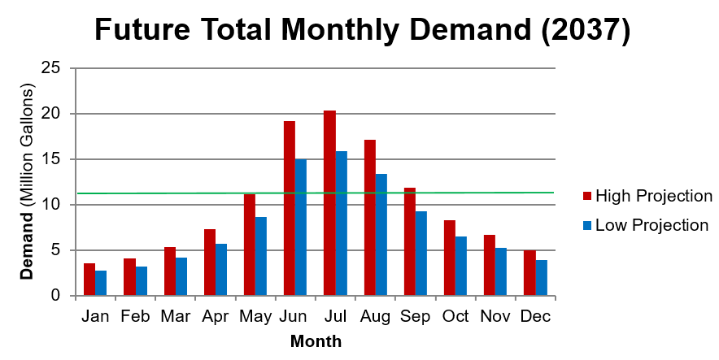
Projected Demands
Pumping Capacity = 12Mil
Pumping Capacity = 10.8Mil
Figure 17: Current Monthly Water Use
Figure 18: Future Monthly Water Use
Table 2: Summer Shortage (Million Gallons)
 | Jun | Jul | Aug | Sep | Total
Current | 2.27 | 3.11 | 0.73 | 0 | 6.11
Future (Low) | 4.23 | 4.76 | 2.27 | 0 | 11.30
Future (High) | 8.451 | 9.23 | 6.04 | 1.07 | 24.8
Hanako, 10
Notes:
Here are monthly demands. The wells pumping at 280gpm will yield 12 million gallons a month, and as you can see, demand exceeds supply during the three summer months. This year they were short by over 6 million gallons, but in the future, with reduced pumping capability, the shortage can increase to 11 to almost 25 million gallons. That’s a problem because ...

Slide 12
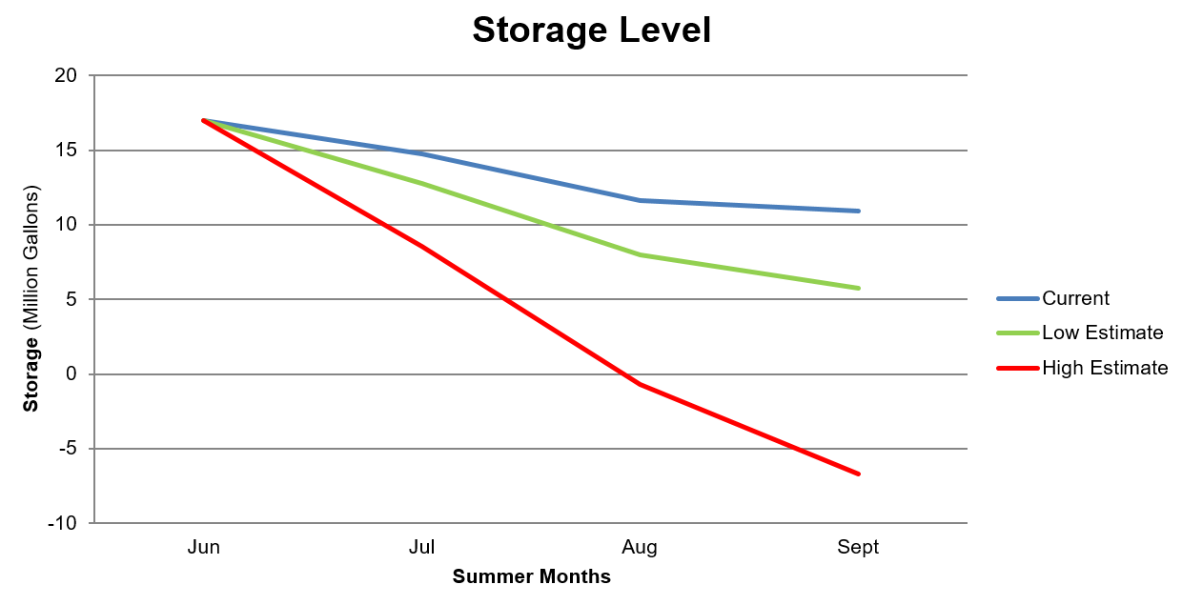
Storage Capacity
-Total storage availability 17 million gallons [5]
2 million gallon closed storage tanks
15 million gallon open storage ponds
*Replenished during winter
Q_{in} = Q_{out} + Δ_{Storage}
Q_{in} = 280 gpm (Max Pumping Capacity)
Q_{out} = Average Demand
Δ_{storage} = Change in Storage
Figure 19: Storage Level Projections
Hanako, 11
Notes:
… because there’s only about 17 million gallons of stored water available. So while people are using more water than the wells can supply during the summer, the shortage is supplemented by the stored water in the tanks and reservoirs which they fill up during the slow winter months. The problem is the possibility of depleting even the stored water based on the projections from the last page. And those projections don’t even consider evaporation and the warming of the earth, so this is a very real threat.

Slide 13
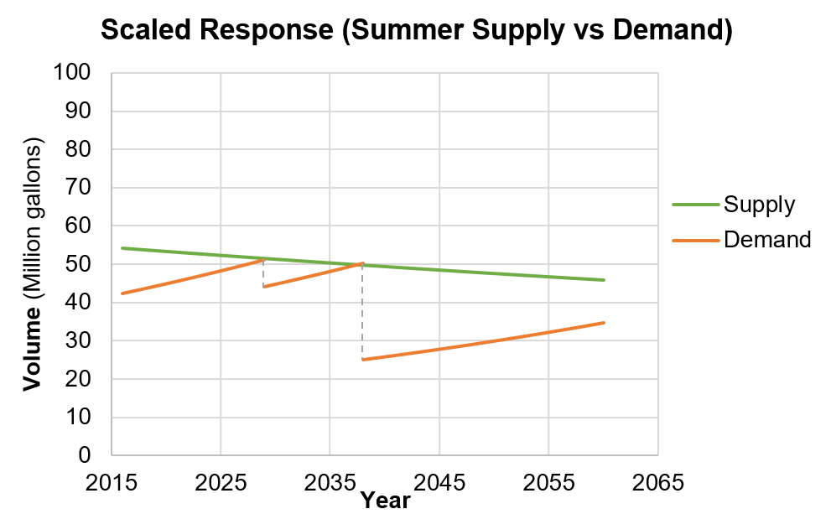
Scaled Response
Crisis 1
2029
Crisis 2
2037
Figure 20: Scaled Response to Water Supply and Demand
Stephen, 12
Notes:
STEPHEN

Slide 14
Scaled Response: Recommended Solutions
-Crisis 1 (2029):
Incorporate voluntary conservation and induce rate hike to discourage excess water usage
Estimated decrease in usage of 17% [6]
Reduces demand to 43.4 million gallons
-Crisis 2 (2037):
Require conservation by implementing low-flow appliances to new construction and property resale
Enact restrictions to 150 gal/capita/day
Conserves 5.331 million gallons during summer months
Reduces demand to 24.8 million gallons
-Crisis 3 (2038):
Excavate and construct additional storage reservoir
Adds 8 million gallons to existing storage
Does not reduce demand, but increases available supply to 34.7 million gallons
-Crisis 4 (TBD):
Outside of 20 year projection
Incorporate wastewater treatment plant to re-use otherwise disregarded wastewater
Approximate Cost: Approximately $1.7 million [7]
Stephen, 13
Notes:
STEPHEN

Slide 15
Scaled Response: Economics
Table 3: Implementation Costs
Response to | Response | Cost | Comment
Crisis 1 (2029) | Increase Rate Structure ($10 monthly fee) | $55,000/year | Use to subsidize conservation efforts
Crisis 2 (2037) | Enforce Restrictions | NA | Reduce to 150 gal/capita/day
Crisis 3 (2038) | 8 Million Gallon Storage Reservoir | Present: $900,000 Future: $1.6 Million | To be functional by 2038
Crisis 4 (TBD) | Wastewater Treatment Plant | Present: $1.7 Million Future: $ 4.5 Million | TBD
*Cost estimates assume 3.22% average inflation [9]
Hanako, 14
Notes:
The PVC pipes that convey well water to town don’t need replacement, but the unstable/unreliable supports of the PVC pipes need to be reinforced. Additional metering will help reduce losses and make implementing restrictions later on much easier.
Excavating and lining a new reservoir will cost about $1.6 million dollars

Slide 16
Staffing Costs
*Assumes all staff is part of the Desert Rose H₂O company
**Hourly wages include overhead costs and billing fees
Hours and Staff Titles were altered as a result of changing the project scope between semesters
Table 4: Staffing Costs [8]
Staff Title* | Estimated Hours** | Wages (Per Hour) | Total Cost**
Project Manager | 192 | $175.00 | $33,600.00
Engineer 1 (Economic Analysis) | 160 | $90.00 | $14,400.00
Engineer 1 (Environmental) | 160 | $90.00 | $14,400.00
Engineer 1 (Risk Management) | 128 | $ 90.00 | $11,520.00
 | ∑ = 640 hours |  | ∑ = $73,920.00
Hanako, 15
Notes:
Our staffing chnaged quite a bit because we ended up not needing t survey, or test water quality. So our new staffing cost is about $74,000

Slide 17
Impacts
Table 5: Project Impacts
Impact | Positive Effect | Negative Effect
Economic | Increases the town’s revenue ($55,000/year) resulting from rate hikes | Increases citizens monthly water billing rates (extra $10/month)
Social | Increases awareness and conservation efforts among the citizens (17% reduction) | Less access to water as a result of restrictions
Environmental | Saves approximately 68 million gallons of water over 20 years | Overpumping causes rate at which water table drops to inrease
Aziz, 16

Slide 18
References
[1] Google Maps, Fredonia, AZ. 2017.
[2] Stefan-Xp, Stone Formations in the Zion National park. 2006.
[3] “Groundwater Watch”, USGS - Science for a Changing World, 2017. [Online]. Available: https://groundwaterwatch.usgs.gov/AWLSites.asp?mt=g&S=365403112452801&ncd=awl.
[4] Sunrise Engineering, “Existing Culinary Water System”, Fredonia, AZ, 2017.
[5] T. Lathim, “Water Distribution and Wastewater Treatment”, Fredonia, AZ 2017.
[6] H., Wendy, “City Continues Conservation”, Western News & Info, 2017. [Online]. Available: http://m.williamsnews.com/news/2017/mar/07/winter-deluge-fills-lakes-city-continues-conservat/?templates=mobile
[7] C. Duza, CivilTech, In person, November 2017.
[8] “SWI - 2017 Hourly Rates”, Shephard-Wesnitzer Inc, 2017.
[9] D. McDonnell, "CENE 486C Capstone: Present Worth Analysis", Northern Arizona University, 2017.
17

